Slide 1


I Cracked Classkick: My Story
Amadu
2025/10/18

Slide 2



Contents
01
How I Found It
02
Live Exploit Demo
03
Why It Happened
04
The Secure Fix
05
Responsible Next Steps

Slide 3
01
How I Found It

Slide 4

One Tuesday After Science Class
I was stuck on a plant-biology question. Classkick told me my answer was wrong, so I opened DevTools to see what was happening behind the scenes. I typed a random word and hit enter. That's when I saw it.
A single PUT request flashed in the Network tab. Inside its payload was every correct answer, listed in plain JSON.
That single glance turned my frustration into a full security audit. I knew I had found something big.

Slide 5
Curiosity Over Cheating
I could have stayed quiet and sailed through assignments, but honest grades matter more than easy A's. I chose to document the flaw, build proof-of-concept tools, and report it responsibly.
This way, teachers can trust the scores they see, and I can prove that ethical hacking beats shortcuts every time.

Slide 6
Why I Code for Good
I run Tuerss.com to hunt bugs in ed-tech, not to sell exploits. Finding this leak was the biggest test yet of my belief that ethical hacking beats shortcuts every time.
Safer Classrooms
Academic Integrity
Future in Cybersecurity
My goal is to make online learning secure for every student and teacher.
I want grades to reflect real knowledge, not exploited loopholes.
This is how I build skills and a reputation for doing the right thing.

Slide 7
02
Live Exploit Demo

Slide 8
Plaintext Answers in Transit
Each keystroke triggers a PUT request to `services.classkick.com`. The payload contains a field called `answers`—a JSON array with every accepted response and its point value. This is the root of the leak.
{ "data": { "type": "fitb_child", "answers": "[{\"answer\":\"Plant 2\",\"points\":0.5},{\"answer\":\"2\",\"points\":0.5}]" , "answer": "s", // Student's WRONG answer ... } }

Slide 9

The Speed vs. Security Trap
Classkick's design choice is clear: embed answers for instant feedback. This avoids a server round-trip but creates a fundamental security flaw by trusting the browser with sensitive data.

Slide 10
Zero-Privilege Exploit
+
=
Student Account
F12 Key
Full Access
No special permissions needed.
Access to browser console.
To all correct answers.

Slide 11
03
Why It Happened

Slide 12
Intercept Answers in Console
Paste this snippet, type any wrong answer, and watch correct ones print instantly. It hooks the browser's request sender to capture the payload.
const originalSend = XMLHttpRequest.prototype.send; XMLHttpRequest.prototype.send = function(data) { this.addEventListener('load', function() { if (this.responseURL.includes('manipulatives')) { const payload = JSON.parse(data); console.log('Correct Answers:', payload.data.answers); } }); return originalSend.apply(this, arguments); };

Slide 13
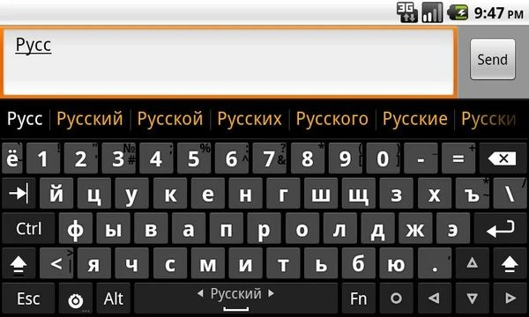
Harvesting Script Walk-Through
The code overrides the browser's send method, waits for Classkick's API calls, and stores every answer in a global cache. Helper functions let you list or export results with a single command.
This turns a five-minute assignment into a thirty-second copy-paste job that teachers cannot detect.

Slide 14
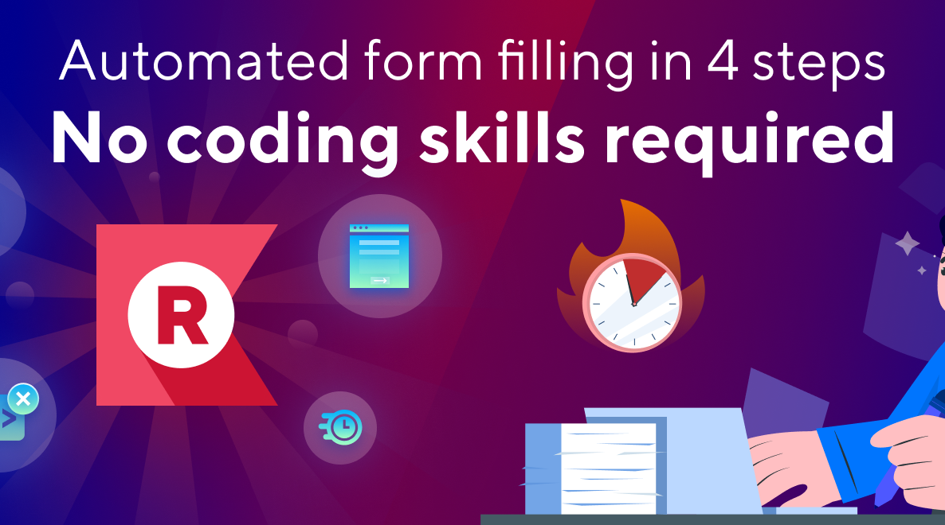
Auto-Fill Without a Trace
I pair the harvester with an AutoHotkey macro. It clicks each text box, deletes the placeholder, and types the correct answer at human speed. Teachers see perfect scores generated faster than most students can open their notebooks.

Slide 15
04
The Secure Fix

Slide 16
Silent Perfect Scores
Because the exploit mimics legitimate activity, server logs show only normal student behavior. This renders formative assessment data useless.
→
→
Classroom of 30
Finishes in pan>
Data is Useless

Slide 17
Millions at Risk
The simplicity of the attack means one shared script can propagate through schools overnight. Every fill-in-the-blank question on every assignment is vulnerable, undermining academic integrity on a national scale.

Slide 18
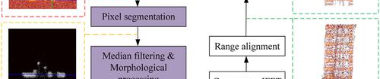
Detection Blind Spot
Current telemetry only captures final submissions, not the speed or sequence of attempts. Without server-side answer storage, there is no baseline to compare against, so even blatant automation evades notice.

Slide 19
05
Responsible Next Steps

Slide 20
The Secure Fix: Move Validation Server-Side
Current (Vulnerable)
Proposed (Secure)
Client sends student answer + correct answers
→
Client sends only student answer
{ answer: "test",
{ answer: "Plant 2" }
correctAnswers: ["Plant 2"] }
The server must compare against its own secure database, ensuring answers never reach the browser.

Slide 21
Rate Limit & Cool Down
To neutralize brute-force scripts, cap each user at 10 checks per minute and impose a 3-second pause after wrong submissions. This stops automation while leaving genuine learners unaffected.

Slide 22
Behavioral Anomaly Alerts
Impossible Speed
Teacher Dashboard
Suspicious Pattern
Flag perfect scores achieved in under 30 seconds.
Surface flagged events for manual review, restoring oversight.
Detect a series of wrong answers followed immediately by correct ones.

Slide 23
Responsible Disclosure Timeline
Day 0
Day 30
Day 60
Day 90
Report Submitted
Acknowledgment & Patch Dev
Patch Validation
Coordinated Public Disclosure

Slide 24

Students as Security Allies
Invite learners to ethical hacking clubs and bug-bounty programs. By celebrating student contributions, we shift campus culture from exploitation to collaboration, turning the curiosity that found this leak into a continuous defense force.

Slide 25
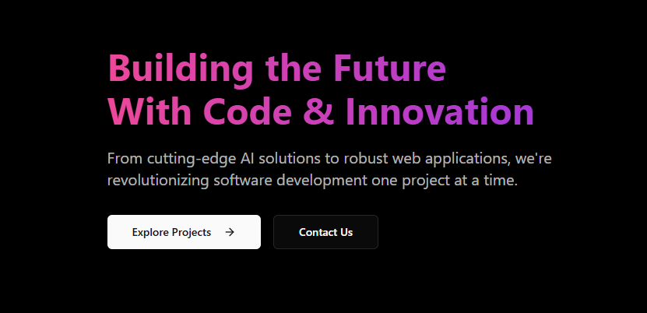
How to Contact me
Name: Amadu Stickler
Company: Tuerss.com
Email: lilami@tuerss.com
Website: https://tuerss.com
BEST CONTACT METHOD: Email (lilami@tuerss.com)
FOR CLASSKICK SECURITY TEAM:
I am available to:
• Provide detailed technical walkthrough
• Demonstrate the exploit in controlled environment
• Assist with patch development and testing
• Verify fix effectiveness
• Coordinate responsible disclosure
• Answer any questions about the vulnerability
• Test proposed fixes before deployment
RESPONSE TIME:
I typically respond to emails within 24-48 hours. For urgent security matters,
please mark the email as "URGENT: Security Vulnerability" in the subject line.

Slide 26
Demand Secure EdTech
Treat K-12 platforms like critical infrastructure. Mandate third-party audits, publish security contacts, and embed privacy-by-design. Admins must add security clauses to procurement contracts.
Mandate Audits
Publish Contacts
Privacy by Design

Slide 27
THANK YOU
Amadu
2025/10/18

